Slide 1
Computer Organization and Architecture (BESE-15a)
Lecture 12
Dr. Hammad Afzal
23rd Nov, 2010

Slide 2
Cache Memory Cache Design

Slide 3
Cache Design
Size
Mapping Function
Replacement Algorithm
Write Policy
Block Size
Number of Caches

Slide 4
1. Size
An approximation (not a fixed rule)
Small enough that overall average cost per bit is close to that of main memory alone.
Large enough that overall average access time is close to that of cache alone.
Other factors
Larger cache, larger is number of gates involved in addressing cache. Thus larger caches are slower to smaller even when built using same IC technology.
The available chip and board area also limits the cache size.
A cache comparison table given in book. Table 4.3 of 7th edition.

Slide 5
2. Mapping Function (1)
We need mapping algorithm because
There are fewer cache lines than memory blocks.
Determine which memory block occupies a cache line.
Three techniques can be used to organize cache (mapping)
Direct Mapping
Associative Mapping
Set-associative Mapping

Slide 6
2. Mapping Function (2)
An example
Cache of 64kByte
Cache line of 4 bytes
i.e. cache is 16k (2¹⁴) lines of 4 bytes
16MBytes main memory
24 bit address
(2²⁴=16M)
Thus memory can be considered as consist of 4M blocks of 4 bytes each for mapping purposes.

Slide 7
Direct Mapping (1)
Each block of main memory maps to only one cache line
i.e. if a block is in cache, it must be in one specific place
Address is in two parts
Least Significant w bits identify unique word
Most Significant s bits specify one memory block
The MSBs are split into a cache line field r and a tag of s-r (most significant)

Slide 8
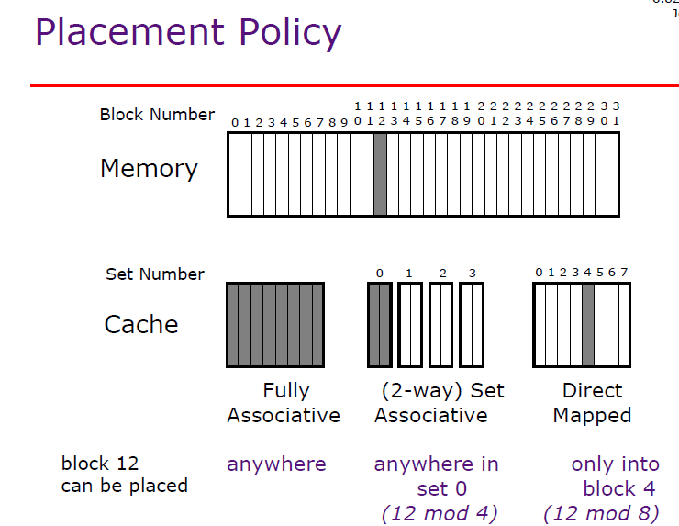

Slide 9
Direct Mapping : Address Structure
Tag s-r
Line or Slot r
Word w
8
14
2
24 bit address
2 bit word identifier (4 byte block)
22 bit block identifier
8 bit tag (=22-14)
14 bit slot or line
No two blocks in the same line have the same Tag field
Check contents of cache by finding line and checking Tag

Slide 10
Direct Mapping Summary
Address length = (s + w) bits
Number of addressable units = 2^{(s+w)} words or bytes
Block size = line size = 2^{w} words or bytes
Number of blocks in main memory = 2^{(s+w)}/2^{w} = 2^{s}
Number of lines in cache = m = 2^{r}
Size of tag = (s – r) bits

Slide 11
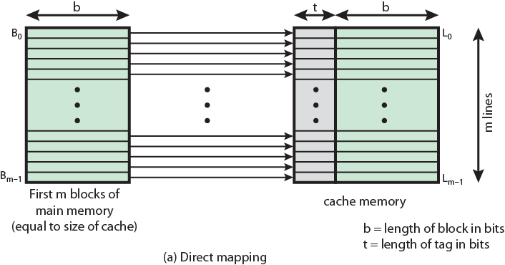
Direct Mapping from Cache to Main Memory

Slide 12
Direct Mapping Cache Line Table
Cache line | Main Memory blocks held
0 | 0, m, 2m, 3m…2s-m
1 | 1,m+1, 2m+1…2s-m+1
…
m-1 | m-1, 2m-1,3m-1…2s-1

Slide 13
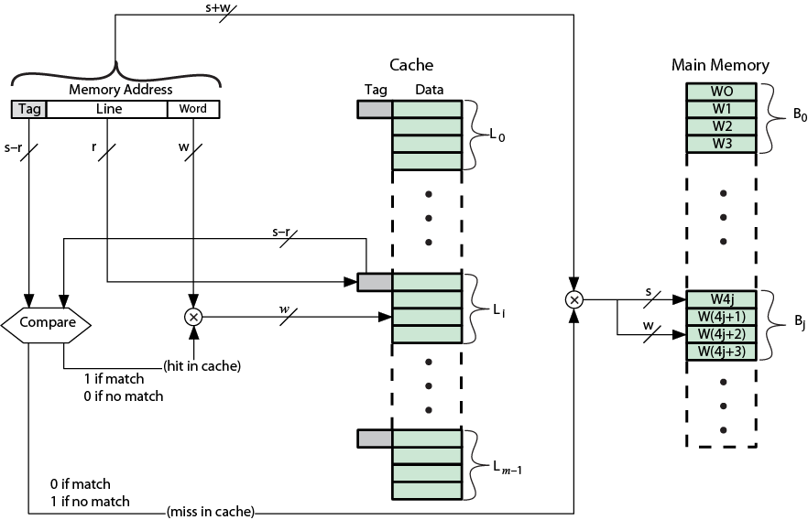
Direct Mapping Cache Organization

Slide 14
Direct Mapping pros & cons
Simple
Inexpensive
Fixed location for given block
If a program accesses 2 blocks that map to the same line repeatedly, cache misses are very high

Slide 15
Associative Mapping
A main memory block can load into any line of cache
Memory address is interpreted as tag and word
Tag uniquely identifies block of memory
Every line’s tag is examined for a match, i.e. In parallel
Cache searching gets expensive

Slide 16
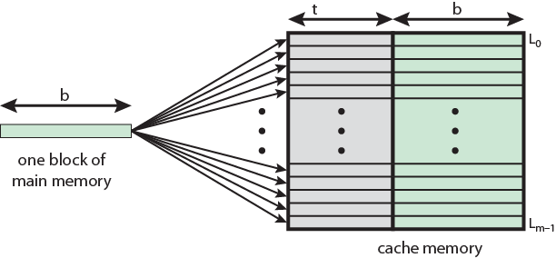
Associative Mapping from Cache to Main Memory

Slide 17
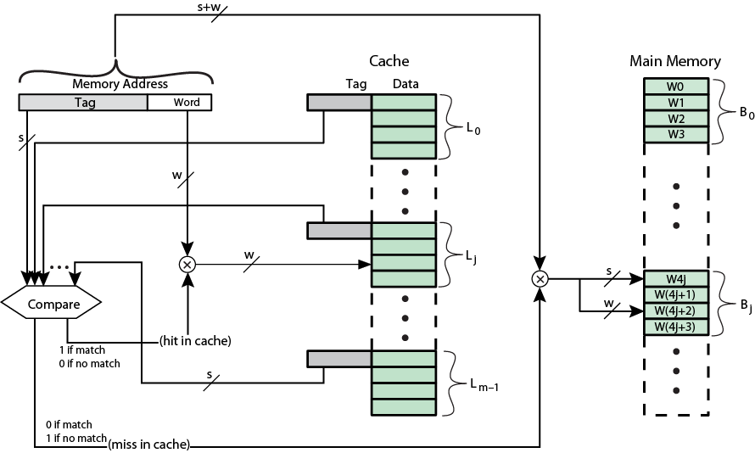
Fully Associative Cache Organization

Slide 18
Associative Mapping Address Structure
Word
2 bit
Tag 22 bit
22 bit tag stored with each 32 bit (4 bytes) block of data
Compare tag field with tag entry in cache to check for hit
Least significant 2 bits of address identify which 8 bit word is required from 32 bit data block

Slide 19
Associative Mapping Summary
Address length = (s + w) bits
Number of addressable units = 2^{(s+w)} words or bytes
Block size = line size = 2^{w} words or bytes
Number of blocks in main memory = 2^{(s+w)}/2^{w} = 2^{s}
Number of lines in cache = undetermined
Size of tag = s bits

Slide 20
Direct Mapping Summary (recap)
Address length = (s + w) bits
Number of addressable units = 2^{(s+w)} words or bytes
Block size = line size = 2^{w} words or bytes
Number of blocks in main memory = 2^{(s+w)}/2^{w} = 2^{s}
Number of lines in cache = m = 2^{r}
Size of tag = (s – r) bits

Slide 21
Set Associative Mapping
Cache is divided into a number of sets
Each set contains a number of lines
A given block maps to any line in a given set
e.g. Block B can be in any line of set i
e.g. 2 lines per set
2 way associative mapping
A given block can be in one of 2 lines in only one set

Slide 22
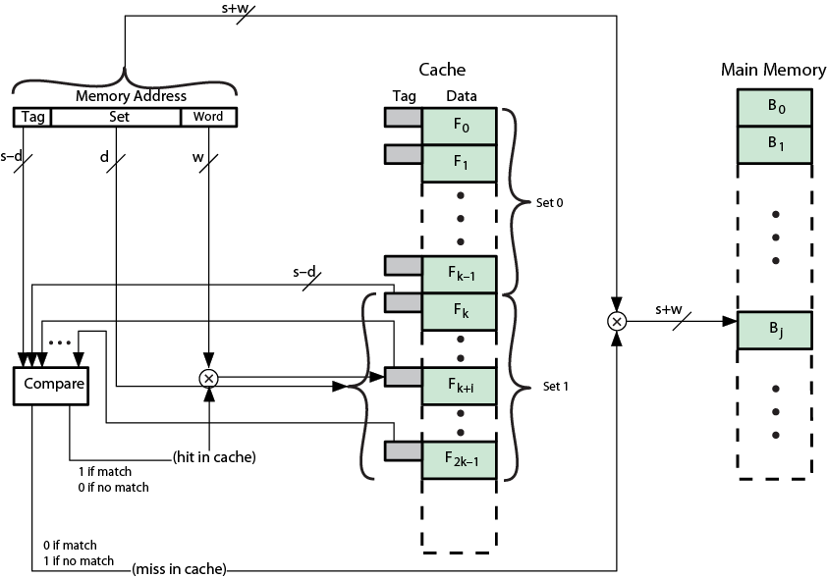
K-Way Set Associative Cache Organization

Slide 23
Set Associative Mapping: Address Structure
Word
2 bit
Tag 9 bit
Set 13 bit
Use set field to determine cache set to look in
Compare tag field to see if we have a hit

Slide 24
Set Associative Mapping Summary
Address length = (s + w) bits
Number of addressable units = 2^{(s+w)} words or bytes
Block size = line size = 2^{w} words or bytes
Number of blocks in main memory = 2^{s}
Number of lines in set = k
Number of sets = v = 2^{d}
Number of lines in cache = kv = k * 2^{d}
Size of tag = (s – d) bits

